Slide 1
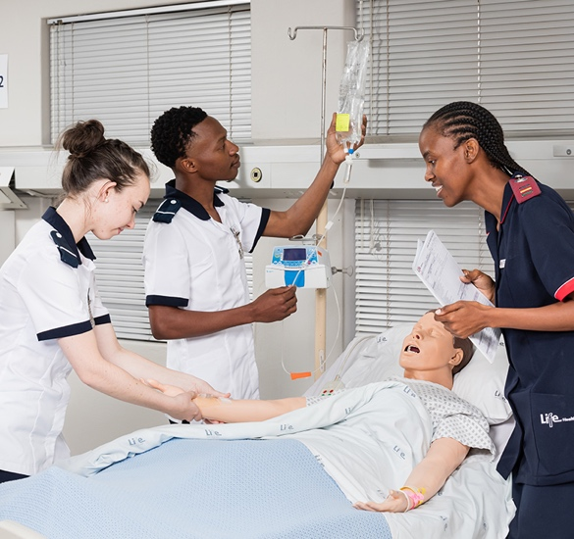
SLO 1.3D1 and 2.5 HC
Sexuality

Slide 2
Objectives
The student should be able to:
Define sexuality-related terms
Freudian theory
Describe sexual development throughout life
Understand the factors influencing sexuality
Identify and describe component of sexual health
Understand sexual rights of patients
Describe sexual variations in experience and expression
Understand how sexuality influences health in general
Discuss factors that can alter sexual function

Slide 3
Introduction
Why is it so difficult to talk about human sexuality?
Why is it important that we as nurses understand sexuality?
Think of a few examples where sexuality need to be considered when working in the clinical field
You can add more information on the Padlet wall as we discuss these questions

Slide 4
Why is it important for a nurse to consider the sexuality of the patient?
Holistic care
Lifespan changes in sexual development that might be abnormal e.g., delayed adolescence
Dysfunction of the reproductive system e.g. prostate problems
Pregnancy
Diseases connected to sexuality
Transmission of infections
Pathology in other systems which has an effect on the reproductive system e.g. cardiovascular disorders
Surgical interventions e.g. prostatectomy, mastectomy, TAH, C-section, normal vaginal birth
Pathology with a psychological influence on sexuality

Slide 5
Professional attitude
Respect and dignity
Treat all patients equally irrespective of your personal view
Be assured of your personal view but always focus on the health and well-being of your patient
Refrain from unprofessional behaviour e.g. flirting, making remarks or suggestions

Slide 6
Sexuality-related terms
Sex
Adolescence
Masturbation
Gender identity
Menstruation
Oral genital sex
Puberty
Gender expression
Sexual orientation

Slide 7
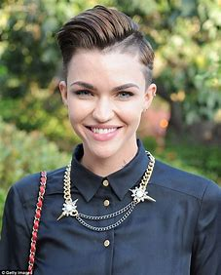
Sexuality-related terms
Intersex
Sexual reassignment treatment
Genital intercourse
Transgenderism
Transition
Sexual transmitted infections

Slide 8
Freudian Theory Kozier & Erb p439-440
Notes:
Freud's theory divides the mind into three parts:
Id: the instinctual, impulsive part driven by desires.
Ego: the realistic part that mediates between the id and reality.
Superego: the moral conscience that upholds societal rules.
Together, they shape human behavior and internal conflict

Slide 10
How does this theory apply to nursing care?
Each phase needs to be successfully complete to prevent fixation:
Oral phase: If you are nursing a baby, ensure that feeding times are pleasurable
Anal phase: Warm caring attitude when changing diapers, positive response during toilet training
Phallic: Child is attracted to the parent of opposite sex (Oedipus or Electra complex). Exploring of genital: don’t respond negatively
Latency: Focus on peers of same sex
Genital: Development of independence and sexual relationships
Teaching parent to make activities of each phase positive

Slide 11
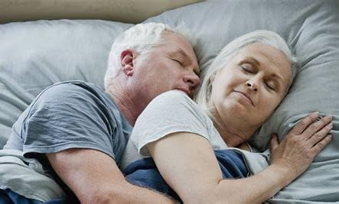
Life span considerations Kozier p 1026
Birth-18 months
Toddler (1-3 years)
Pre-school (4-5 years)
School age (6-12 years)
Adolescence (12-18 years)
Young adults (18-40 years)
Middle age (40-65)
Older adults (65- )

Slide 12
Components of sexual health
Body image
Personal preference
Self-image
Gender expression
Gender identity
Androgyny
Notes:
Androgyny means having a blend of both masculine and feminine characteristics, or not being distinctly male or female in appearance, behavior, or identity

Slide 13
Sexual rights: Sexual health, human rights and the law-WHO
“ the possibility of having pleasurable and safe sexual experiences, free of coercion discrimination and violence”.
Control of fertility: Abortion, contraception, STI
Healthcare related to STI, sexual dysfunction
Sexual violence, genital mutilation
Freedom to diverse sexual practices
Non-discrimination e.g., HIV, sex workers, teenage sexual activity
Privacy and confidentiality
Right to education and informed decision making
Conscientious objection

Slide 14
Post-Class activity-Sexual right, human rights and the law
Make use of the Padlet discussion wall created to express your ideas on the following topics:
Confidentiality and teenage sex
Criminalisation of certain sexual activities e.g., sex workers, homosexuality
Legal definition of rape and cultural practices
On page 15 there is a discussion on conscientious objection

Slide 15
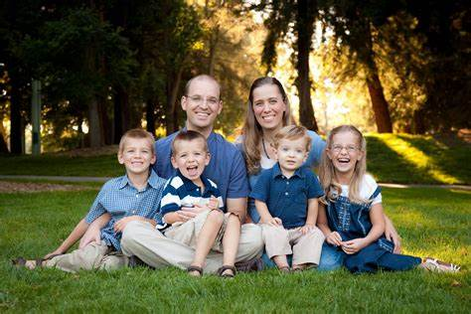
Factors influencing sexuality (read more on Moodle)
Family
Personal expectations and ethics
Religion
Culture

Slide 16
Factors altering sexual function (Kozier & Erb p 1035-1038)
Past and current factors:
Sociocultural factors e.g. strict upbringing, workload, privacy
Psychological factors e.g. sexual abuse, rape, fear of failure
Cognitive e.g. low self-esteem, sexual orientation
Sexual problems e.g. relationship issues
Health problems e.g. heart conditions, injury, surgeries such as mastectomy
Medication e.g. side effects prevent erection or reduce libido
Recreational drugs interfere with normal sexual activity
Alcohol e.g. delay ejaculation or prevent erection

Slide 17
Sexual health
Physical changes during adolescence
Examples of STI’s
Evidence-Based practice (1029 Kozier and Erb)
Sexual health: respect, with consent, free of coercion, fear, discrimination, violence, stigma and shame
Evidence of abuse, rape, domestic violence

Slide 18
Sexual practices and health
Oral-genital sex
Anal stimulation
Genital intercourse
Sexual desire disorders
Sexual arousal disorders
Orgasmic disorders
Sexual pain disorders
Satisfaction problems
Sexual transmitted diseases

