Slide 1
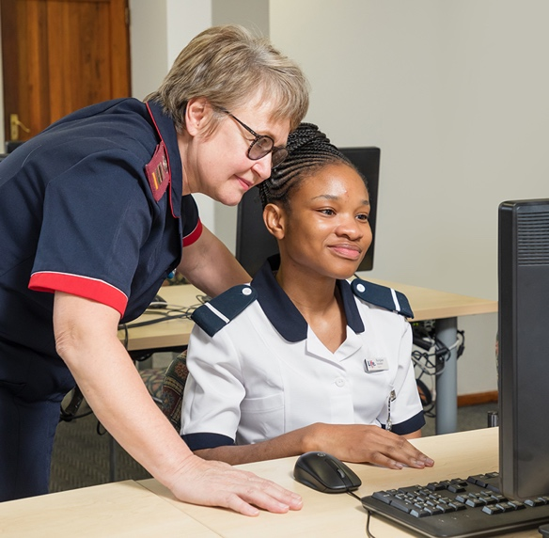
SLO 2.3 Culturally sensitive nursing

Slide 2
Notes:
Nursing in a multicultural society presents challenges such as overcoming language barriers, respecting diverse cultural beliefs about health and illness, and addressing varying expectations of care. Nurses must navigate cultural differences in communication styles, dietary preferences, and traditional healing practices while ensuring equitable care. However, exposure to a multicultural environment enriches nursing practice by fostering cultural competence, enhancing problem-solving skills, and broadening perspectives. This diversity strengthens healthcare teams and allows nurses to develop more personalized, empathetic care approaches, ultimately leading to improved patient outcomes and a deeper understanding of global health perspectives

Slide 3
Specific outcomes
Define terminology related to culturally responsive care
Identify and describe cultural issues in health
Identify cultural skills needed by the nurse
Cultural diversity in the workforce
Identify barriers in transcultural communication

Slide 4
Introduction
Culture can be defined as the characteristics of a particular group, race or community. This includes language, norms and values, perceptions, social conventions, food and clothing.
Providing culturally sensitive care is an important component of patient centered-care
Nurses must strive to enhance their ability to provide patient-centered care by reflecting on how their and the patient's culture's, values, and beliefs impact the nurse-patient relationship

Slide 5
Notes:
It is of great importance to understand the different terms and concepts used in the discussion on culture and cultural norms. Not only will you be able to answer questions in tests and exams but will also be able to participate sensibly in discussions of topics.
Let's answer a few questions to test how much you know about these topics. I have posted the link in the chat. I will give you 20 minutes to answer these questions

Slide 6
Cultural concepts | Definition
Subculture | A group within a certain culture e.g. feminists, nurses
Multicultural | Relating to or characterized by the presence, recognition, or coexistence of diverse cultural groups within a society, organization, or setting. e.g. family with a father that is English and the mother Zulu
Culture | Thoughts, communication, actions, customs, beliefs, religion
Heritage | Things passed down from previous generations
Diversity | The state of being different e.g. sex, age, culture
Race | Biological (genetics) but also social and cultural
Ethnicity | A group with distinctive characteristics e.g. Latino

Slide 7
Cultural concepts | Definitions
Nationality | Citizenship in a specific country
Religion | System of believes and practices, ethical values holding to the existence of a higher power e.g. Islam, Christianity but with many variations in a specific religion
Ethnocentrism | The believe in the superiority of your own culture
Prejudice | Preconceived notions or judgement that is not based in sufficient knowledge e.g. racial prejudice
Stereotyping | Making an assumption that an individual reflects all characteristics reflected in a group assuming that all mineworkers are of lessor intelligence, waste money and participate in strikes
Racism | Assumptions held about racial groups, assumptions that races are exclusive and are inherently unequal and ranked hierarchically.
Discrimination | Discrimination against any individual on the basis of their skin colour, race or ethnic origin. Individuals can discriminate by refusing to do business with, socialize with, or share resources with people of a certain group.

Slide 8
Culturally sensitive nursing
What is a norm?
What are group norms?

Slide 9
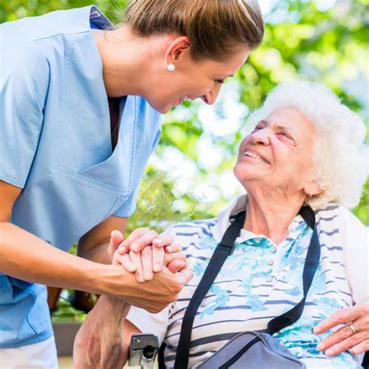
Definition of norm:
Standards of proper or acceptable behavior Equivalent to everyday do’s and don'ts
An average level of development or achievement
Something such as a behavior or way of doing something that is usual or expected
(Miriam Webster Dictionary)

Slide 10
Group norms are ground rules that can encourage a group to work efficiently and discourage behaviors that hinder its effectiveness. Although unwritten, they govern how group members interact with each other, work as a team, make decisions, and even how they dress

Slide 11
Group activity
Access the Forum discussion board under the topic: Culturally sensitive nursing and answer the following question:
What are the group norms that strive to enhance nursing as a profession?

Slide 12
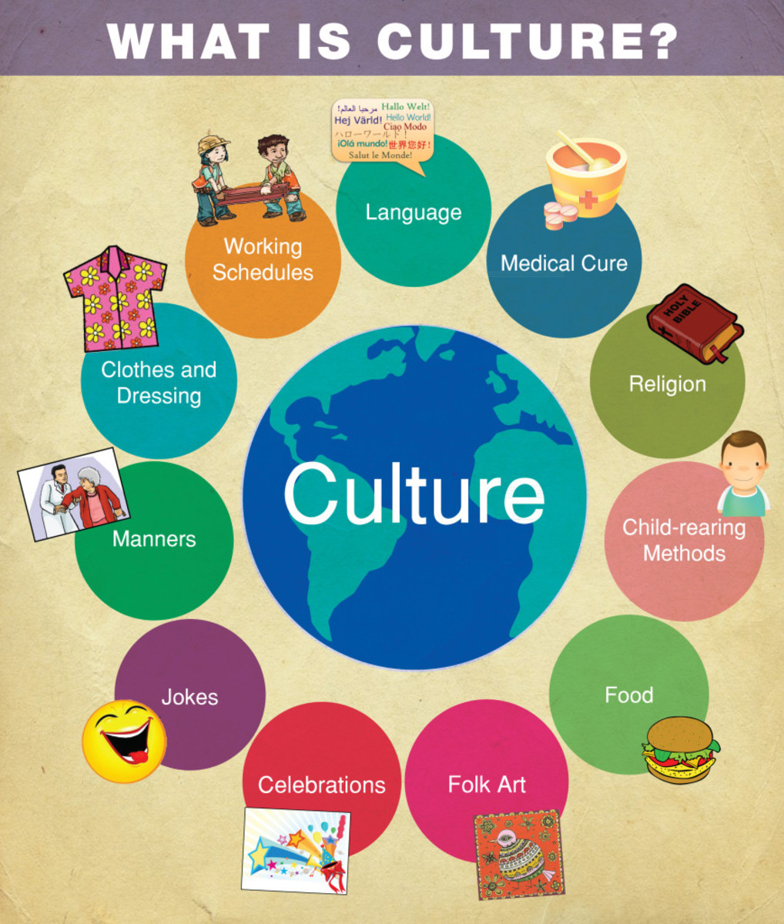
What is culture?
Culture is the total of the lifestyle of a group of people. It includes:
Values
Religion
Aesthetic standards
Language expressions
Thought patterns
Behavioral norms
Communication styles
Interaction so that the culture is never static it is ever evolving

Slide 13
Why does a group develop a culture?
Survival
Never static
Notes:
A group of people develop a culture to ensure their survival within a specific physical and human environment.
A culture and the people who are part of it, are in interaction so that the culture is never static

Slide 14
Cultural issues in Health
Health beliefs and practices
Family patterns
Space and time orientation
Naming systems
Assessment interview
Dietary considerations
Dignity
Personal hygiene/ elimination
Medical intervention
Sexuality / Family planning
Palliative care / Death and dying
Communication lines
Disposal of body parts
Charms and amulets
Notes:
Nursing in multicultural contexts requires sensitivity to diverse health beliefs and practices, as well as understanding family dynamics that influence decision-making. Space and time orientation can vary significantly across cultures, affecting patient comfort and expectations. Naming systems, dietary restrictions, and personal hygiene practices must also be considered to deliver respectful and effective care. Challenges arise in conducting culturally appropriate assessments, addressing dignity, and managing medical interventions like sexuality, family planning, or palliative care. Communication barriers, including varying preferences for disclosing information and using charms or amulets, further complicate care. Proper handling of issues such as the disposal of body parts after surgery or rituals surrounding death is essential to respecting cultural values and providing holistic care.

Slide 15
How does a nurse develop cultural skills?
Developing self-awareness
Conveying cultural sensitivity
Culture shock
Notes:
Self-awareness is crucial for nurses to provide culturally sensitive care. Nurses must reflect on their own beliefs, biases, and cultural assumptions to avoid imposing them on patients. By understanding how their personal values influence interactions, they can approach patients with openness and respect. Developing self-awareness helps nurses recognize and appreciate cultural differences in health beliefs, communication styles, and practices, allowing them to adapt care plans accordingly. This introspection fosters empathy, improves patient trust, and ensures equitable care that honors everyone's cultural background.

Slide 16
Cultural concepts
Culture
Subculture
Multicultural
Heritage
Diversity
Race
Ethnicity
Nationality
Ethnocentrism
Prejudice
Racism
Discrimination
Stereotyping
Notes:
Let's test our understanding of cultural issues in nursing. Does it matter that we understand cultural differences and how does our perception of culture influence our nursing care.

Slide 17
Cultural diversity in the workforce
Diversity gives nurses additional opportunities to learn about more effective approaches for various patients from different cultures.
This promotes the development of more culturally competent practices and helps nurses share information with one another that allows them to adjust approaches to care.
Cultural awareness
Cultural knowledge
Cultural skill
Respect for different Cultures

Slide 18
Identify barriers in transcultural communication
Ethnocentrism - We all have a natural tendency to look at other cultures through our own lenses
Stereotyping and discrimination
Language or communication barriers
Conflict due to different values

Slide 19
Who feels overwhelmed?
Who of you are thinking that it is impossible?
Who can offer a solution in one sentence?
Notes:
My solution: I strive to see the world through God’s eyes. He made us all, loves us all, wants to save us all. We are only one human race.
"After this I looked, and behold, a great multitude that no one could number, from every nation, from all tribes and peoples and languages, standing before the throne and before the Lamb, clothed in white robes, with palm branches in their hands, and crying out with a loud voice, 'Salvation belongs to our God who sits on the throne, and to the Lamb!'"

Slide 20
Read the following article and add information to the summaries that you are going to study from:
Seven Steps Nurses Can Take to Provide Culturally Sensitive Care. Add the information to your summaries

