Slide 1
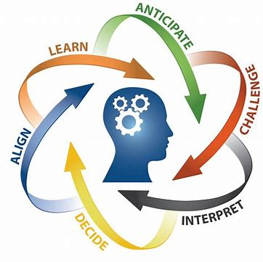
Evidence-Based Practice (EBP)
Programme:
Level:
Module: FNP

Slide 2
Learning Outcomes
At the end of this lesson the students shall be able to:
Define Evidence-Based Practice (EBP)
Describe the significance of EBP in nursing and healthcare
Apply EBP in nursing
Q Jan-March 2021
Q4 July-Sept 2021

Slide 3
What is EBP?
When providing healthcare services, evidence-based practice means taking into account patients' desires and preferences in addition to clinical skill, personal knowledge, and the best available research data.
Soleymanifar, P., Kamran, A., Jafari, M., Savadpoor, M. and Nasiri, K., 2019. Hospital nurses’ perception of evidence-based practice: A descriptive-analytical study. Nursing Practice Today, 6(2): 94-99

Slide 4
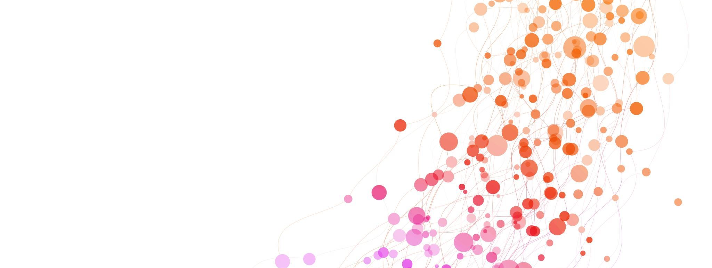
EBP within a South African context
There is a dearth (shortage/gap) of research pertaining to evidence-based practice in South Africa as compared to the rest of the world.
There has been some attempts to introduce EBP in a limited form in SA
The lack of access to the internet and consequently current journals, reference books, and publications, as well as the availability of a library, led to the poor acceptance of EBP in South Africa.
Major hurdles that could counteract the expected benefits of EBP include unstable electricity supply and load reductions in South Africa, poor internet connectivity due to structural defects aggravated by power outages, and limited bandwidth (Cilliers and Wright, 2017).
Hayward, A.R. and Dube, E.L., 2023. Information computer technology resources and skills are vital for effective implementation of evidence based practice in nephrology nursing. International Journal of Africa Nursing Sciences, 19, p.100582.

Slide 5
EBP within a South African context cont...
Governmental and other national policies and strategies promote EBP.
National Core Standards for Health Care Establishments (NDOH, 2011)
However, there appears to be a lack of will within most practice settings (including nursing education).
The South African government through its National Strategy guiding Framework supports an idea of a digitally skilled workforce (National Strategic Direction for Nursing and Midwifery in South Africa (2020/21–2025/26:13), however the Provincial Reports on the state of Readiness of Nursing Colleges to offer the National Qualifications in Nursing (NDoH, n.d.) highlighted inconsistencies and inadequacies amongst Nursing Colleges

Slide 6
Phases of EBP
converting information needs about clinical problems into clear questions
seeking evidence to answer those questions
evaluating (critically appraising) the evidence for its validity (truthfulness) and usefulness
evaluating performance and the outcome of the decision.
integrating findings with clinical expertise, patient needs, and patient preferences to reach a decision as to the optimum course of action, and then applying this decision

Slide 7
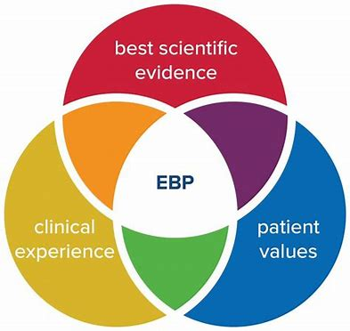
Definition of EBP
Evidence-based practice refers to the use of the best research evidence, personal knowledge and clinical expertise, and patients’ values and preferences for the provision of healthcare services.
West, C., Guemann, M. and Ilhan, E., 2022. You Ask# PEDroAnswers, a global social media campaign to help physiotherapists improve their searching skills to find high-quality evidence. European Rehabilitation Journal, 2(1): 1-5.

Slide 8
WHY USE EBP?
Encourage consistency of practice and procedures.
Encourages innovation.
Will ensure long-term improvements in nursing practice.

Slide 9
WHY USE EBP?
Most appropriate way of ensuring that patients receive the most effective care possible.
Essential component of the development of nursing science.
Closes the gap between research and practice.
Fits in with the ethos of ‘doing things right’.

Slide 10
WHY USE EBP?
Offers benefits to the staff.
Improves ability to provide efficient care
Increases professional role satisfaction
Improves critical thinking
Leads to clinical excellence

Slide 11
YOUR ROLE IN EBP
•Use the nursing literature
•Use evidence-based practice
•Teach evidence-based practice

Slide 12
BENEFITS OF EBP
Reduces unacceptable individual variances in care
Renews the professional spirit of the nurse
Become better patient advocates
Keep updated with technologies.

Slide 13
BARRIERS TO EBP
Gaps in Evidence
Too Much Evidence
Inapplicability of evidence to a specific setting or patient
Lack of Time
Limited Access to Resources
Resistance to Change
Knowledge Gaps
Organizational Constraints

Slide 14
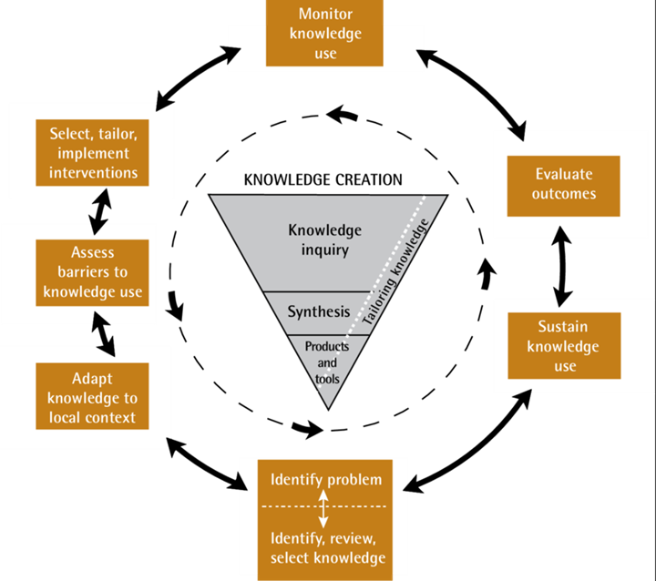
APPLYING EBP IN PRACTICE
Advancing knowledge translation in primary care - Scientific Figure on ResearchGate. Available from: https://www.researchgate.net/figure/The-knowledge-to-action-framework_fig1_230616512 [accessed 12 Dec., 2023

Slide 15
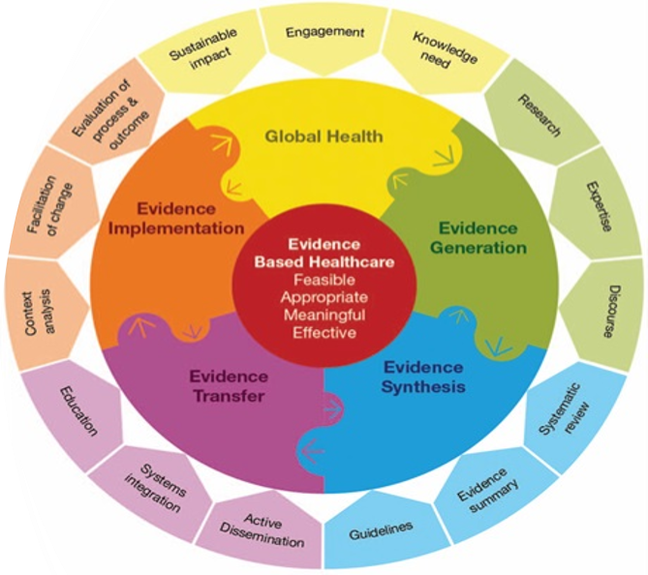
Joanna Briggs Institute Evidence-based model

Slide 16
CONCLUSION
You now have a sensible grasp of Evidence-Based Practice (EBP) in the field of nursing and healthcare, as a result of this session. Not only can you now identify EBP, but you have also learned how important it is in determining the effectiveness and caliber of patient care.
By accepting EBP, you are committing to a standard of care that is based on the most up-to-date and trustworthy evidence available, not simply an approach.
The knowledge and abilities you have gained today will be the cornerstone for making well-informed, evidence-based decisions as you progress in your nursing career.

