Slide 1
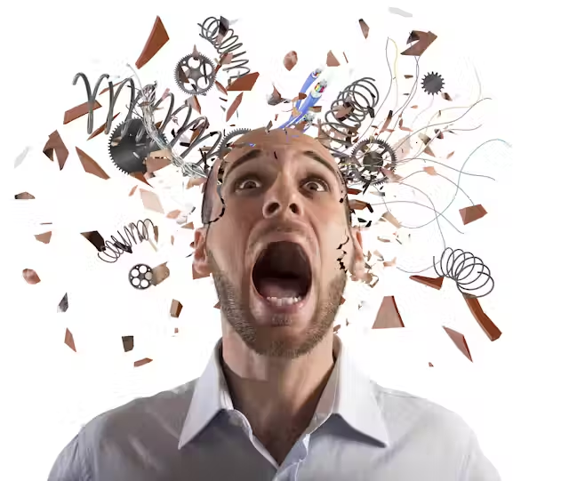


APS 2025
STRESS AND COPING

Slide 2
LEARNING OUTCOMES
Differentiate between stress and a stressor
Explain the sources of stress
Discuss in detail the different indicators of stress
• Physiological Indicators
• Psychological indicators
• Cognitive indicators
Explain coping strategies
Describe coping with stress and the nursing management of stress in detail
Q Jan-March 2021
Q4 July-Sept 2021

Slide 3

WHAT IS STRESS?

Slide 4
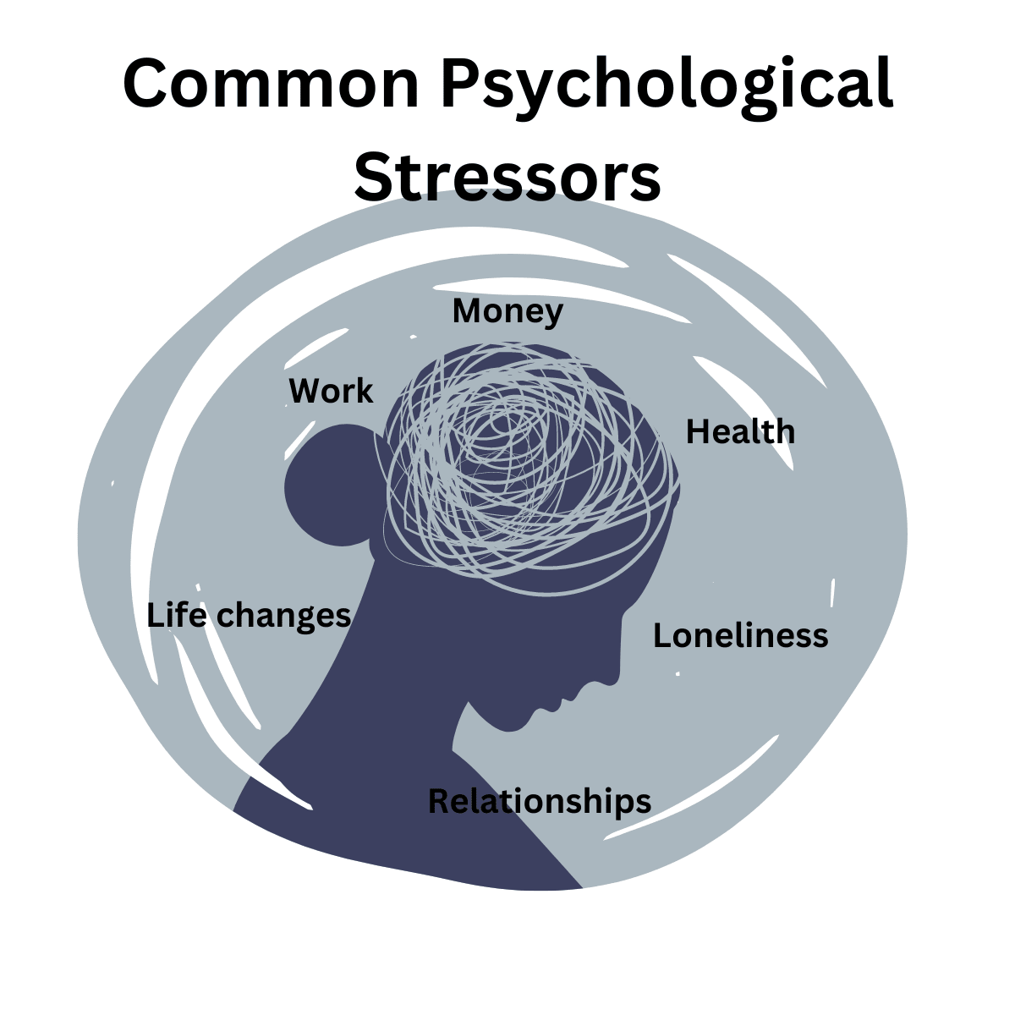
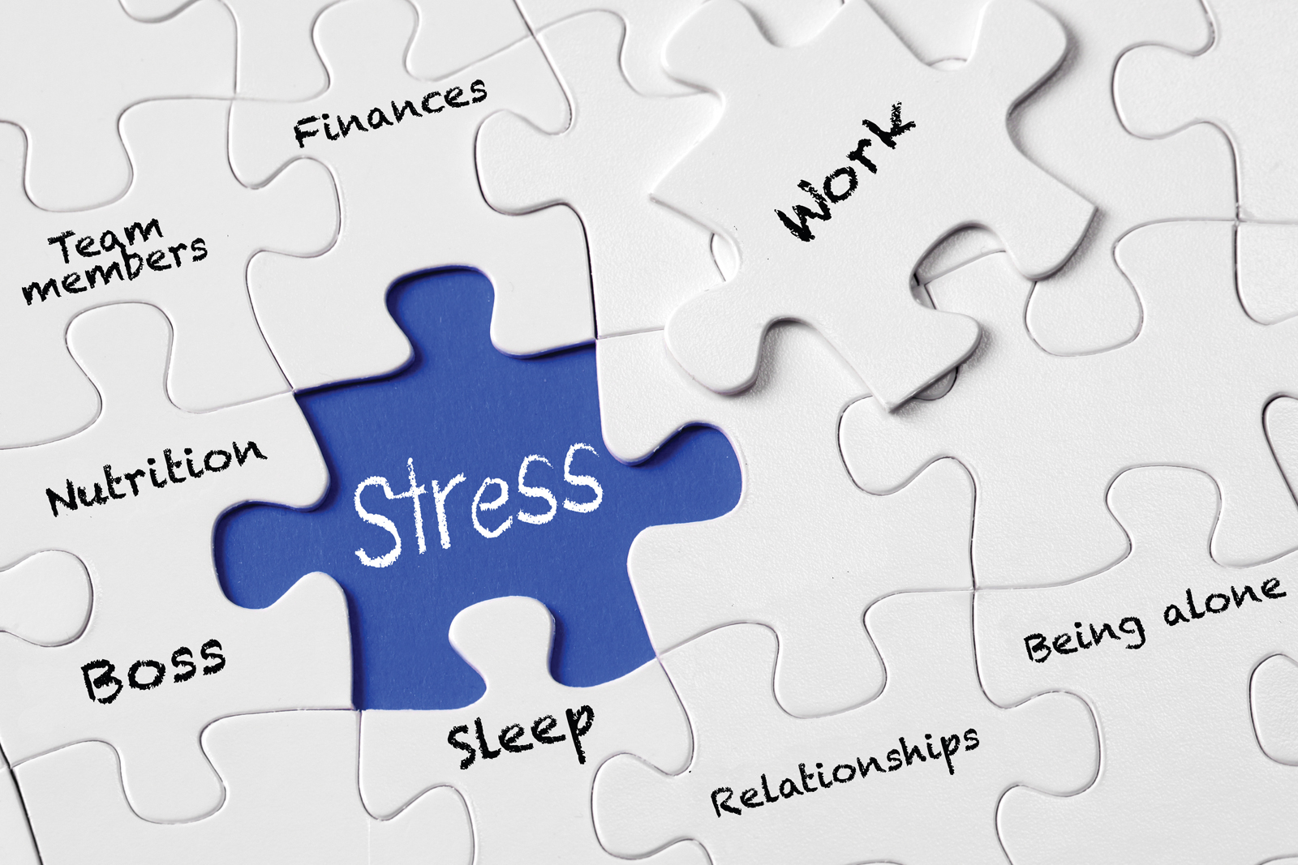
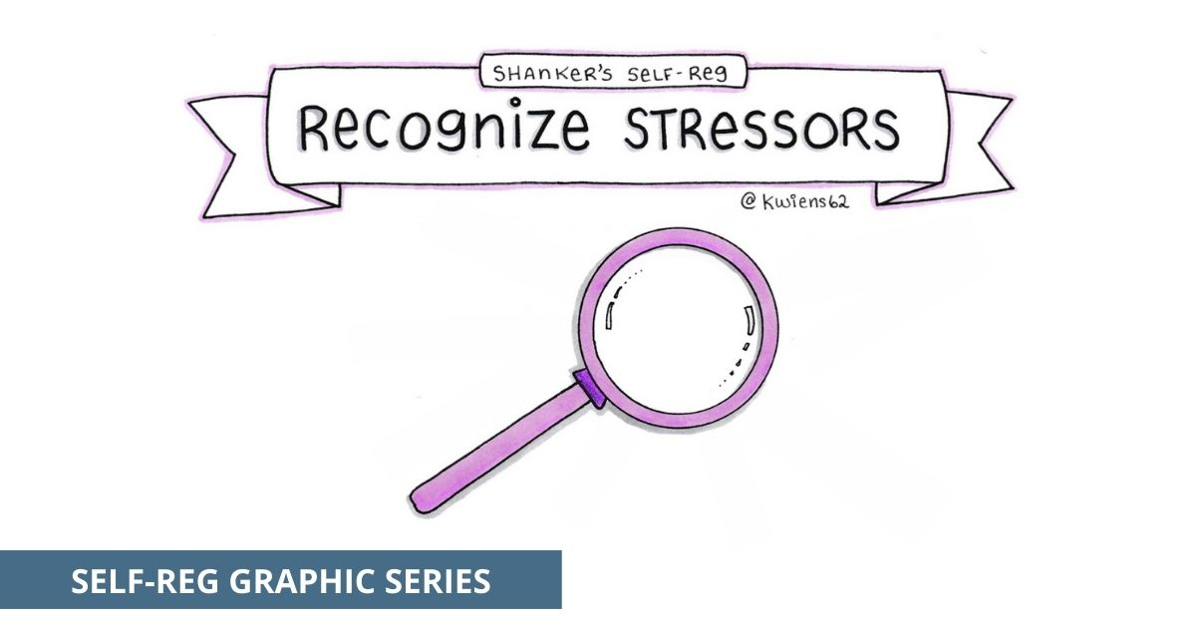



WHAT IS A STRESSOR?

Slide 5
SOURCES OF STRESS
• Work, finances, unemployment, and work pressure
• Relationships, marriage, divorce, and parenting
• Death, illness, injury, and trauma
• Bullying, emotional abuse, and poor mental health
• Lack of support, coping skills, or control
• Day-to-day inconveniences and hassles

Slide 6
INDICATORS OF STRESS

Slide 7
INDICATORS OF STRESS
Psychological indicators
  Anxiety and Fear
  Anger
  Depression
  Ego Defense Mechanism

Slide 8
INDICATORS OF STRESS
Cognitive indicators
  Problem Solving
  Structuring
  Self Control
  Suppression
  Fantasy

Slide 9
COPING STRATEGIES
Coping is dealing with change successfully or unsuccessfully.
Coping strategy is a natural or learned way of responding to a changing environment or specific problem.
Types of Coping strategies:
  Problem focused coping
  Emotion focused coping
Long term - These focus on preventing or reducing stress over time and improving overall well-being.
Short term - These are used to quickly reduce stress in the moment, but they may not solve the root cause.
Process of coping can be adaptive or maladaptive

Slide 10


COPING WITH STRESS AND THE NURSING MANAGEMENT OF STRESS

Slide 11
STRATEGIES THAT THE NURSE CAN IMPLEMENT TO REDUCE STRESS AND PREVENT BURNOUT
Plan a daily relaxation programme with meaningful quiet time to reduce tension.
Establish a regular exercise program to direct energy outward.
Study assertiveness techniques to overcome feelings of powerlessness in relationships with others.
Learn to accept failures (your own and others) and make it a constructive learning experience
Accepts what you cannot change.
Develop collegial support groups to deal with feelings and anxieties generated in the work setting.
Participate in professional organisations to address workplace issues.
Seek counselling if indicated to help clarify and cope with concerns.

Slide 12
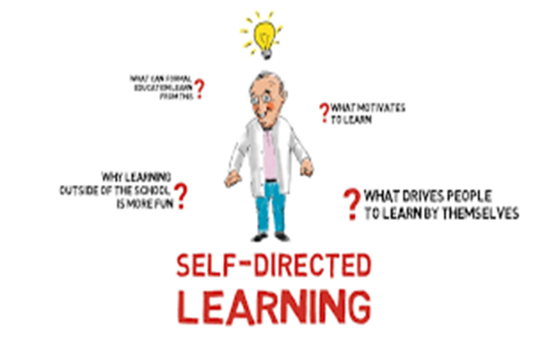
SELF DIRECTED LEARNING CONTINUE
Complete the follow tool to assess your own stress levels.
Once you have established your personal stress levels, implement positive coping mechanisms.
If you are really battling, please make use of Employee Health Solutions

Slide 13
RESOURCES
Berman, A. Snyder,S.J. & Franden, G.(2021). Kozier & Erb’s Fundamentals of Nursing. Concepts, Process and Practice.11th edition. Pearson. New Jersey Chapter 42. p 1067 -1079

Slide 14


