Slide 1
SLO D1 2.5 HC 2.6
Loss grief and dying
Notes:
Loss, grief and dying are not the most pleasant topics to discuss. However, as nurses we do not have the option to avoid these difficult topics. It is part of working in a hospital. As much as the expectation is to guide our patients this session can also assist you in your own experience of loss, grieving, death and dying.
But it is not only about death and dying but also about loss and the process of grief that comes with loss.

Slide 2
Learning outcome:
The student will be able to provide nursing care that encompasses principles of reflection, culturally sensitive communication to provide a conducive and stress-free environment for patients, family and fraternity, from birth to dying.
Q Jan-March 2021
Q4 July-Sept 2021
Notes:
Learning outcome:
The student will be able to provide nursing care that encompasses principles of reflection, culturally sensitive communication to provide a conducive and stress-free environment for patients, family and fraternity, from birth to dying.
Loss and grieving, death and dying, are universal human experiences that touch everyone at some point in life. Grief is the natural response to losing someone or something significant, bringing a range of emotions like sadness, anger, and confusion. Death, an inevitable part of life, often forces people to confront their own mortality and navigate the complex process of saying goodbye. Understanding these topics helps us support ourselves and others through difficult times, fostering compassion, resilience, and acceptance in the face of loss.

Slide 3
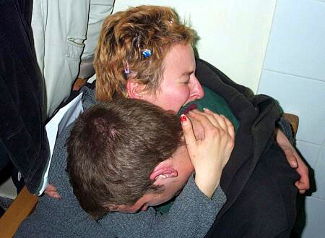
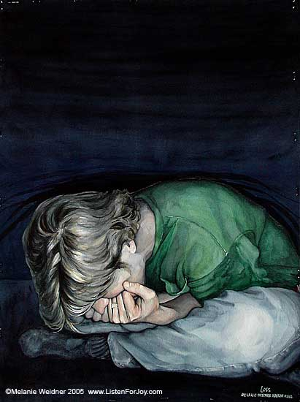
Notes:
Life holds few certainties, but one undeniable truth is that every person will, at some point, experience loss, grief, and death. While individuals cope in their own unique ways, there are common signs, symptoms, and behaviors that are universally observed. Understanding these can help you, as a nurse, navigate these challenging experiences with greater empathy and support.

Slide 4
Specific outcomes:
Define loss, grief and death and related concepts
Identify and describe the sources of loss
Identify and describe the types of grief responses
Identify and describe the factors influencing loss and grief
Describe the stages of grieving by Kubler-Ross
Notes:
Nurses play a crucial role in supporting patients and families through the process of loss, death, and dying. Understanding the different types of loss—whether physical, psychological, anticipatory, or sudden—enables nurses to identify the need for compassionate and individualized care. This knowledge helps them recognize emotional, spiritual, and physical needs, facilitating effective communication, grief support, and end-of-life care. By being aware of the grieving process and cultural perspectives on death, nurses can offer comfort, promote dignity, and assist patients and families in coping with loss in a meaningful way.

Slide 5
Concepts
Grief –response to the emotional experience of loss/social process
Loss-situation where something of value is lost or no longer available
Bereavement-subjective response experienced by those who is left behind by a person with whom they have share a significant relationship
Notes:
It is important to understand the meaning of the words and concepts we use when talking about the topic of death and dying. We will not be able to identify and report on the responses related to grief or loss if we don’t have a clear understanding of the meaning of these words.
Grief –response to the emotional experience of loss/social process.
Loss-situation where something of value is lost or no longer available.
Bereavement-subjective response experienced by those who is left behind by a person with whom they have share a significant relationship.

Slide 6
Concepts
Mourning- behavioral process through which a person resolve grief. It can be influenced by culture, believes and customs
Living will (advanced directive)-instruction given by individuals that specify the actions that needs to be taken in the event that they are not able to decide for themselves
Notes:
Mourning- behavioral process through which a person resolve grief. It can be influenced by culture, believes and customs.
Living will (advanced directive)-instruction given by individuals that specify the actions that needs to be taken if they are not able to decide for themselves.

Slide 7
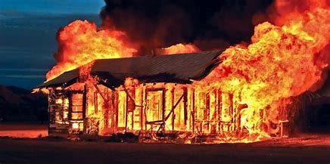
Types of loss
Actual loss-visible to others
Perceived loss-can not be verified by others (loss of independence)
Anticipatory loss (husband dying)
Situational loss-job, child, loss of limb
Notes:
Types of Loss
Actual Loss – This refers to a tangible loss that is visible and recognized by others. It includes events such as the death of a loved one, destruction of property, or the loss of a pet. Because this type of loss is apparent, others can offer support and acknowledge the grieving process.
Perceived Loss – Unlike actual loss, perceived loss is not always visible or validated by others. It is a personal and internalized experience, such as losing independence due to aging or illness, feeling a loss of self-worth after retirement, or experiencing an emotional detachment in a relationship. Since it is subjective, it may not always receive the recognition or support it deserves.
Anticipatory Loss – This occurs when someone begins to grieve a loss before it happens. For example, a person whose spouse is terminally ill may begin the grieving process even before their loved one passes away. Anticipatory loss allows individuals to emotionally prepare, though it does not necessarily lessen the pain when the loss becomes a reality.
Situational Loss – This type of loss is caused by unexpected life events that disrupt normalcy. Examples include losing a job, experiencing a miscarriage, going through a divorce, or losing a limb due to an accident or illness. Situational loss often leads to emotional distress, financial instability, or identity crises.

Slide 8
Types of loss
Developmental loss-children leaving home/growing old
Loss of aspect of self- mental of physical ability during aging
External objects-money, house
Notes:
Developmental Loss – These losses occur naturally as a part of life’s progression. They include children growing up and leaving home, aging, retirement, or the transition into different life stages. While developmental losses are expected, they can still evoke deep emotional responses such as loneliness, nostalgia, or feelings of irrelevance.
Loss of an Aspect of Self – This involves losing physical or mental abilities, often because of aging, illness, or injury. Examples include cognitive decline, chronic illness, loss of mobility, or diminished sensory functions such as hearing or vision loss. These losses can impact self-identity, confidence, and independence.
Loss of External Objects – This involves losing possessions that hold financial or sentimental value. It can be the result of theft, natural disasters, financial hardships, or personal mistakes. Losing a home, money, or cherished belongings can lead to feelings of insecurity, stress, and grief, especially when those items symbolize stability or important memories.

Slide 9
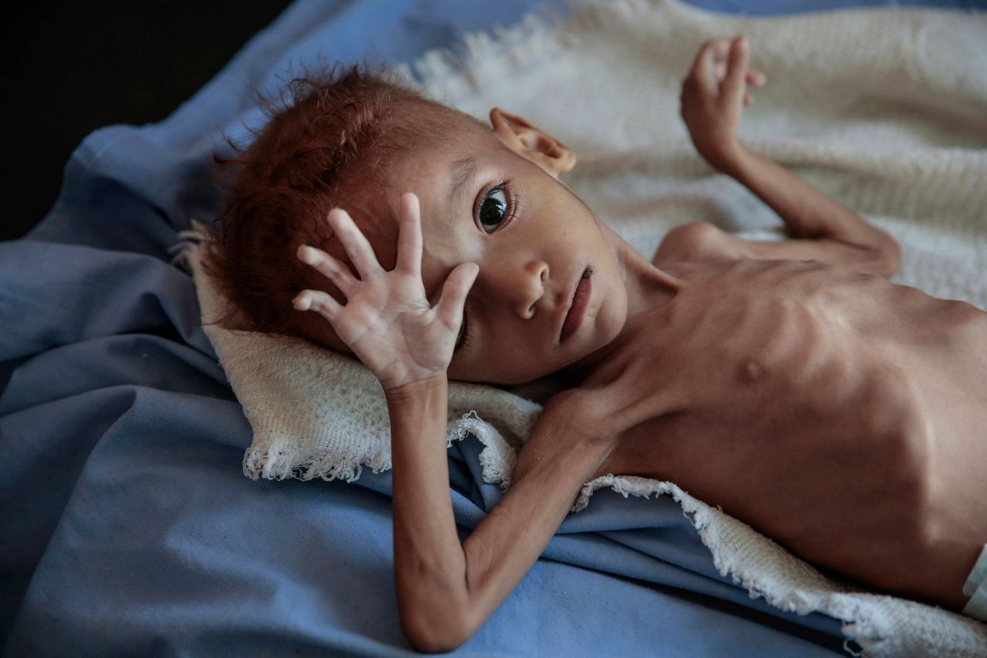
Types of loss
Familiar environment-child going to university
Loss of loved ones-death or disease that changes personality
Notes:
Types of Loss
Loss of a Familiar Environment – Moving away from a familiar setting can be emotionally challenging, particularly when transitioning to a new phase in life. For example, when a child goes to university, they may experience homesickness, anxiety, or uncertainty as they adjust to a new academic and social environment. Similarly, parents may struggle with feelings of emptiness or sadness as they adapt to their child’s absence. This type of loss involves a shift in routine, support systems, and emotional security, requiring time and effort to establish a sense of belonging in a new space.
Loss of a Loved One – The death of a family member, close friend, or significant other is one of the most profound and painful losses a person can experience. However, loss is not always limited to death; it can also occur when a loved one undergoes a significant personality change due to disease, such as Alzheimer’s or a traumatic brain injury. In these cases, individuals may grieve the person they once knew, struggling with the emotional pain of witnessing their loved one’s transformation. Coping with such a loss requires emotional resilience, social support, and, in many cases, professional guidance to navigate the complex emotions involved.

Slide 10
More examples of loss
Death- worst form of loss
Divorce
To be away from family
Loss of possessions
Death of pets
Loss of a limb
Change of appearance e.g., mastectomy, facial changes
Loss of function e.g., work or sports
Notes:
There are several other examples that can be used in a test or exam when it comes to loss.

Slide 11
More examples of loss
Loss of valued possessions
Retirement
Loss of safety
Loss of health status
Natural disasters
Loss of role e.g., parent role after death of children
Children growing up
Moving house

Slide 12
Clinical manifestations of grief
Anxiety
Depression
Weight loss
Difficulty in swallowing
Vomiting
Fatigue
Headaches/ dizziness
Fainting
Blurred vision
Notes:
Grief manifests in a variety of ways, including emotional, physical, cognitive, and behavioral symptoms. Emotionally, individuals may experience sadness, anger, guilt, or numbness. Physically, they might suffer from fatigue, sleep disturbances, or appetite changes. Cognitive symptoms can include difficulty concentrating and forgetfulness, while behavioral changes may involve withdrawal from social interactions or restlessness. As a nurse, recognizing these signs is crucial in providing compassionate care. Active listening, offering emotional support, and encouraging healthy coping mechanisms, such as counseling or support groups, can help patients navigate their grief. Being patient and empathetic allows nurses to create a safe space for healing.

Slide 13
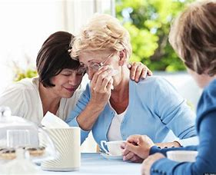
Clinical manifestations of grief
Skin rashes
Excessive sweating
Palpitations
Chest pain
Dyspnea
Altered libido
Concentration loss
Sleeping disturbances
Notes:
Considering the list of symptoms, it is always important to exclude other possible reasons for the physical signs and symptoms identified in patients.

Slide 14
Types of grief responses
Normal grief
Anticipatory grief
Disenfranchised grief- unable to acknowledge loss e.g. suicide
Complicated grief –out of proportion or out off acceptable social norms
Bereavement disorder- lasting more than 12 months and loss of ability to function
Notes:
Grief is a natural response to loss, but it can manifest in different ways. Normal grief follows a typical mourning process, where individuals gradually adapt to their loss over time. Anticipatory grief occurs before an impending loss, such as when a loved one is terminally ill, allowing some to begin processing emotions in advance. Disenfranchised grief arises when a person cannot openly acknowledge their loss due to societal stigma, such as in cases of suicide, miscarriage, or the death of an estranged partner, leading to isolation and unrecognized mourning. Complicated grief is an intense, prolonged, or exaggerated response that falls outside social norms, where the individual struggles to accept the loss and move forward. In extreme cases, it may develop into bereavement disorder, where grief persists beyond 12 months, severely impairing daily functioning and emotional well-being, often requiring professional intervention to facilitate healing.

Slide 15
Complicated grief
Failure to grief
Refusal to participate in grieving activities e.g., do not attend funeral
Persistent guilt and low-self esteem
Search for the loved one prolonged physical difficulties
Poor relationships with family members
Notes:
Complicated grief is an intense, prolonged form of grief that disrupts a person’s ability to function in daily life. Unlike typical grief, which gradually lessens over time, complicated grief persists with overwhelming sadness, longing, and difficulty accepting the loss. Individuals may experience emotional numbness, guilt, or even anger, often struggling with intrusive thoughts about the deceased. This condition can interfere with relationships, work, and overall well-being, sometimes leading to depression or anxiety. Professional support, such as therapy or counseling, is often necessary to help individuals process their grief and find a path toward healing.

Slide 16
Effect of grief
Can be harmful physiological if not resolved
Mourning needed to resolve process of grief
Grief helps individual to cope with loss and leads to acceptance of reality
Grieving process essential for mental and physical health
It is a social process
Positive when it leads to new insights, openness to others and a renewed sensitivity
Notes:
Grief is a natural response to loss that serves both emotional and psychological purposes. It allows individuals to process their loss, express emotions, and gradually adapt to life without their loved one. The effects of grief can be physical, emotional, and social, including sadness, fatigue, changes in appetite, and withdrawal from others. While painful, grief is essential for healing, helping individuals find meaning, preserve memories, and eventually regain a sense of normalcy. By working through grief, people can integrate their loss into their lives and move forward while honoring the person they lost.

Slide 17
Factors that influence the normal process of grief
The way a person dies (will be discussed in slide 19-21)
The connection with the deceased/intense emotions
The position of the person in the family
The history of a person
Personality
Social factors
Notes:
There are several factors that influences the normal grieving process and need to be considered when the response to loss is been evaluated.
The connection with the deceased/intense emotions (the loss of a spouse will be more intense that a lost of a school friend)
The position of the person in the family (the loss of a father who provides or the provider of emotional care e.g., a mother)
The history of a person ( there is a greater acceptance after a long sick bed)
Personality (stronger personalities may have a shorter period of grief)
Social factors (e.g., financial struggles of the death of the breadwinner)

Slide 18
Factors that influence the normal process of grief
Need to be brave or in control (parents want to protect their children)
Multiple losses (losing a whole family)
Extremely high emotional value in the diseased person e.g., losing a spouse
Uncertainty about loss (missing person)
Lack of support (e.g., no family to support with children)

Slide 19
Factors that influence the normal process of grief
The way a person dies
Natural
more acceptance
the pain that was involved
guild as to personal matters
time to accept
Notes:
Another aspect to consider specifically related to death, is what led to the death of a family member of friend. It might be due to natural causes, an accident or suicide.

Slide 20
Factors that influence the normal process of grief
The way a person dies
Accident
who was guilty
how did it happen
financial implications
where did it happen

Slide 21
Factors that influence the normal process of grief
The way a person dies.
Suicide
A lot of questions for the family
Guilt (I should have seen the signs)

Slide 22
Factors that influence the normal process of grief
The age of the person
Culture
Spiritual beliefs
Gender
Socio-economic support
Notes:
More factors that might influence the process of grieving.

Slide 23
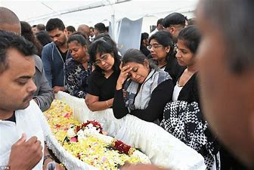
Religious factors
Xhosa/Zulu-ritual sweeping of area of death asking soul to go home
Christianity-support of spiritual leader, prayer very important, belief in life after death
Hindu-mourning loss at diseased home
Wash and cloth body, priest leads in prayer, covers body with flowers in preparation of after life, cremate body
Notes:
For nurses it is very important to consider the religious practices that patients may hold to and is very important to the patient and family members. Irrespective of your own religious or spiritual affiliation or believes, it is important to find out what those practices are and allow and make provision to adhere to those practices as far as possible. The following are only examples. You will find on Moodle a document that will guide you into making short summaries of different religions to help your patient in a culturally sensitive manner.

Slide 24
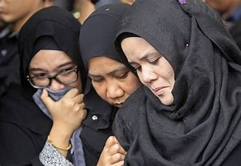
Religious factors
Jews- burial within 24 hours, cremation forbidden, washes and shrouds body by own appointed people, prayers said by priests
Muslims- belief in life after death, rituals in washing and dressing body, prayers to help soul to after life, bury person as soon as possible
Notes:
More examples of different practices.

Slide 25
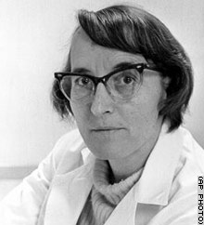
Kubler Ross
Notes:
Elisabeth Kübler-Ross was a Swiss-American psychiatrist best known for her groundbreaking work on death and dying. She introduced the five stages of grief—denial, anger, bargaining, depression, and acceptance—in her 1969 book On Death and Dying. Her research revolutionized the way society understands the grieving process, particularly for terminally ill patients and their families. Kübler-Ross was a pioneer in palliative care and hospice movements, advocating for compassionate end-of-life care. Her work continues to influence psychology, counseling, and healthcare practices worldwide.
Kübler-Ross’s theory of the five stages of grief remains widely applicable today in understanding how people process loss, whether due to death, illness, or major life changes. While grief is now recognized as a more individualized and nonlinear process, her framework provides a valuable foundation for counselors, healthcare professionals, and individuals coping with loss. It helps normalize emotions experienced during mourning and offers guidance for providing emotional support. Though modern research has expanded on her work, her model remains a crucial tool in grief counseling, palliative care, and discussions around end-of-life issues.

Slide 26
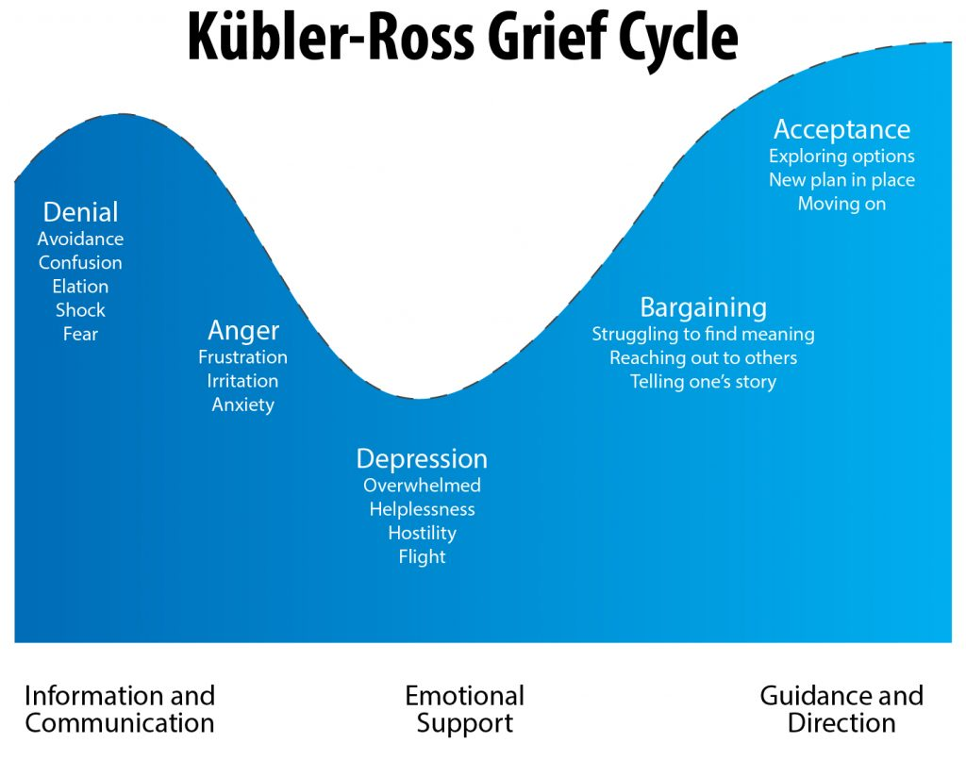
Notes:
This a visual aid to assist you to remember the different stages of grief and what each stage entails. With new insights, we know that each person will go through the different stages at their own pace and their own sequence. This grief cycle is therefore only a suggestion on how it may happen in some patients.

Slide 27
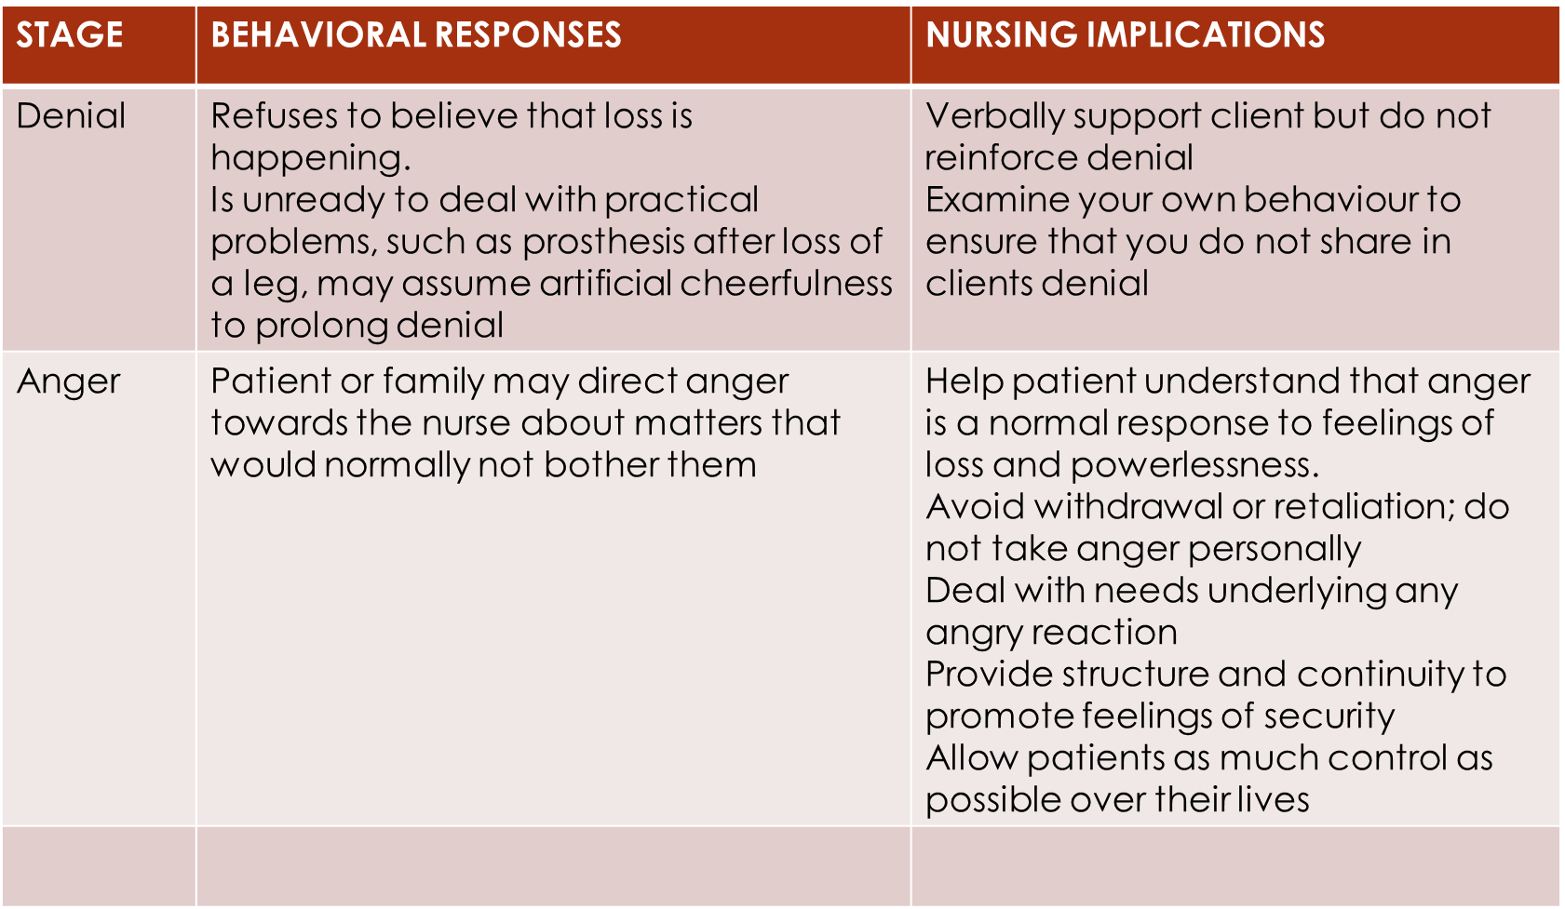
Notes:
When guiding a patient through the denial stage of grief, it is essential be patient, gentle and empathetic. Denial serves as a coping mechanism, allowing individuals to gradually process their loss without becoming overwhelmed. Nurses and caregivers should acknowledge the patient's feelings without forcing them to accept reality too soon. Encouraging open communication, offering a listening ear, and providing factual yet compassionate information can help them slowly come to terms with their loss. Creating a safe and supportive environment allows the patient to move through denial at their own pace while feeling understood and cared for.

Slide 28
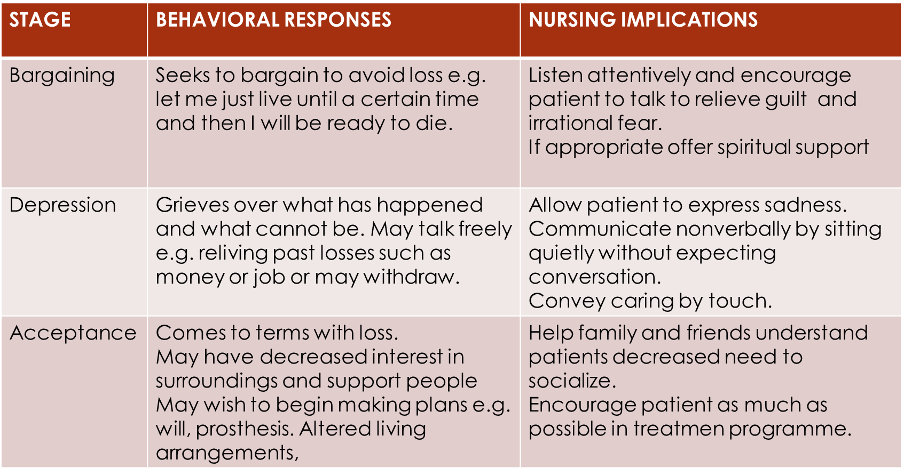

Slide 29
Notes:
There are different illustration on the stages of grief. We need to remember that every person might have a different experience in their grief.

Slide 30
Death
Notes:
As much as we always say that we need to integrate APS and GNS, when we talk about death in the APS space, we need to focus our minds on the more psychological aspects. When we do death in GNS the focus will be more on the physical care aspects.
Another aspect is to consider the management of the patient and his/her family. In preparation for clinical work or assessments you need to consider both the patient and the family.

Slide 31
Definitions
Death: permanent loss of all brain stem activity and a permanent incapacity for consciousness. Indicate the shut down of neurological and circulatory function
Persistent vegetative state: loss of cognitive function but breathing and heartbeat remains
Palliative care:
Providing relief but not cure
Terminal care:
Providing care to a dying patient
Notes:
Again, it is important to understand the meaning of words and concepts used when we discuss death.

Slide 32
Aspects to consider
Legal
Ethical
Spiritual
Biological
Psychological
Notes:
The concepts of legal, ethical, spiritual, biological, and psychological aspects are crucial in many areas of life, particularly in healthcare, end-of-life care, and personal decision-making. Legal aspects refer to laws and regulations that govern rights, responsibilities, and justice. Ethical considerations focus on moral principles and values that guide behavior and decision-making. Spiritual aspects involve personal beliefs, faith, and the search for meaning, especially in times of crisis. Biological factors pertain to the physical and physiological processes of the body, including health and illness. Psychological aspects deal with emotions, cognition, and mental well-being, influencing how individuals cope with challenges and life changes.

Slide 33
Emotional response of patient to dying
Hopelessness
Despair
Crying
Depression
Anger
Violence
Acting out
Passivity
Notes:
It is important to view the dying person holistically, Recognising the emotional responses. All these mentioned responses are normal, may not be visible in all patients and may vary in intensity. As nurses we need to recognise it and deal with it in a compassionate and caring way.

Slide 34
Emotional effect on caregivers
Fatigue
Depression
Anger
Disruption of family
Severe stress
Notes:
Healthcare workers who care for dying patients often experience significant emotional and physical strain. Fatigue can result from long hours, physically demanding tasks, and the emotional toll of providing end-of-life care. Depression may develop as workers grapple with the emotional weight of witnessing suffering and loss regularly. Anger can arise from feelings of helplessness or frustration with the limitations of care. The disruption of family life occurs as healthcare workers may struggle to maintain personal relationships due to demanding schedules or emotional exhaustion. Overall, severe stress is common, as the intensity of their responsibilities combined with emotional burdens can lead to burnout and a decline in overall well-being.

Slide 35
Care of the dying patient
Focus on physical and emotional needs
Don’t avoid the topic
Don’t avoid eye contact
Don’t give false assurances
Isolation of patient
Don’t ignore patient’s talk on fears and anxieties
Be available to talk
Don’t treat unconscious patient as an object
Keep on talking to the patient
Be aware of what the patient is going through
Consider spiritual needs of patient
Notes:
When we refer to a dying patient, it can include several stages. The patient can be fully aware or can be totally unconscious. When a question is asked, consider the stage the patient is in, but the same principles will be applicable. Always keep in mind that hearing is the last sense to fade.
Caring for a dying patient on an emotional level requires compassion, presence, and active listening. It's important to create a safe space where the patient can express their fears, regrets, or hopes without judgment. Offering reassurance and comfort, whether through gentle words, touch, or simply being there, can help alleviate anxiety. Acknowledge their emotions, allowing them to feel, to hear and be understood. It’s also helpful to provide a sense of peace by addressing any spiritual or existential concerns they may have. By demonstrating empathy and patience, healthcare workers can help the patient feel supported during this difficult time.

Slide 36
Care of the dying patient
Focus on the value of the patient
Focus on patients’ needs rather than nurses needs
Show compassion by touch and just being there. Sometimes no need for words
Be positive e.g., “you are doing very well today, or you really cope very well with your situation”
Acknowledge the stage of grief the patient is in.
Communication with family
Include them into decision making
Notes:
Here are a few pointers to help you in caring for the dying patient. Remember the focus is on psychosocial and not physical care. That will be done in GNS.

Slide 37
Death-related legal issues
Advance healthcare directives
Living will vs euthanasia
- often vague
- must be updated regularly
- conflict between wishes and good care practices
Death-bed declarations
Testamentary statements
Notes:
Death-related legal issues are crucial for nurses to understand, as they are often the healthcare professionals present at a patient's deathbed. Awareness of concepts such as euthanasia, living wills, deathbed declarations, and testamentary statements ensures that nurses can provide ethical and legal support to patients and their families. Euthanasia involves end-of-life decisions, while a living will outline a patient's medical preferences. Deathbed declarations and testamentary statements can have legal significance in inheritance and other matters. Understanding these concepts helps nurses navigate sensitive situations with professionalism and care.

Slide 38
Death-related legal issues
Do-not-resuscitate orders
Organ donation
Notes:
Two other related concepts are do-not-resuscitate orders which is often a decision made by the patient or family in collaboration with the medical doctor. Organ donation is another aspect to consider. Usually, the decision has been made by the patient and will be considered with specific criteria.

Slide 39
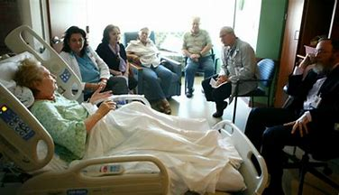
Consideration of religious and cultural practices
Individualised care
Option to die at home
Disclosure of prognosis
Who to call at time of death
“bad and good deaths”
Preparation of the body
Autopsy
Organ donation method of burial
Death related rituals
Make a short summary of the following religions: Roman catholic, Muslim, Judaism, Buddhism
Notes:
It is of utmost importance to consider certain religious and cultural practices when it comes to dying patients. The final show of dignity and respect lies with adherence to preferences by the patient and family. It is difficult to always know every little detail of all the cultures and religions and therefore helpful to make a short summary of each denominations’ rituals in managing death and dying. It will assist you in rendering compassionate and culturally sensitive care to patients and their families. By asking if you do not know, you will indicate a caring attitude.
See the document posted on Moodle to assist you in making short summaries.

Slide 40
Rights of the dying patient
To be treated as a human being till I die
To maintain a sense of hopefulness
To be cared for with a sense of hope
To express feelings and emotions about approaching death
To participate in decisions
To expect care although cure is not possible
Not to die alone
Notes:
The rights of a dying patient ensure dignity, autonomy, and compassionate care during their final moments. These rights include the right to be informed about their condition, the right to refuse or accept treatment, and the right to pain management and palliative care. Patients also have the right to make advance directives, such as living wills, and to appoint a healthcare proxy. They should be treated with respect, receive emotional and spiritual support, and have the right to die in a peaceful environment. Upholding these rights helps ensure a dignified and comfortable end-of-life experience.

Slide 41
Rights of a dying patient
To be free from pain
To be answered honestly
Not to be deceived
To have help from my family and help for them to accept my death
To die in peace and dignity
To retain my individuality and not be judged for my decisions
To discuss and to practice my religious beliefs
That my body will be respected after death
Notes:
Dying patients have the right to dignity, respect, and autonomy in their final days. They have the right to make decisions about their care, including refusing or requesting treatment, and to have their wishes honored regarding end-of-life care. Patients should be informed about their condition and options, allowing them to make informed choices. They also have the right to receive pain management and comfort care to ease suffering. Additionally, dying patients have the right to be surrounded by loved ones, with privacy and emotional support, ensuring they are treated with compassion and humanity during this critical time.

Slide 42
Rights of a dying patient
To be cared for by caring, sensitive and knowledgeable people who will attempt to understand my needs and will be able to gain some satisfaction in helping me face my death.

Slide 43
Coping meganism for staff working with dying patients
Death is causing stress
Continuous interrupting of functions
Feeling of failure
Come face to face with own feelings on death and dying
Ongoing counseling and support needed to be able to care effectively for dying patients
Notes:
Healthcare workers caring for dying patients can benefit from developing effective coping skills to manage the emotional challenges of their work. Practicing self-care, such as taking regular breaks and ensuring time for relaxation, helps prevent burnout. Talking with colleagues or counselors provides an outlet for processing feelings and sharing experiences. Setting emotional boundaries is essential to avoid becoming too personally involved while still offering compassionate care. Additionally, finding meaning in their work, such as knowing they are providing comfort during a critical time, can help healthcare workers maintain resilience and emotional well-being.

