Slide 1

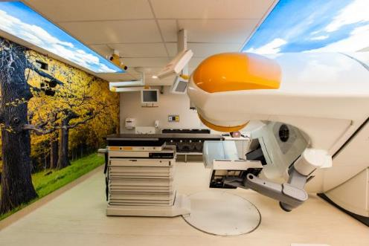
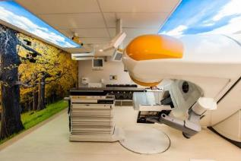
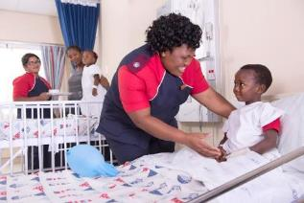
Labour Relations Lecture
Revision 3
Esther Ndlovu
19 May 2022

Slide 2
AGENDA
- Purpose of the Act
- Freedom of Association
- Workplace Forums
- Trade Unions and Employers Organisation
- Dispute Resolution
- Code of good practice

Slide 3
PURPOSE OF THE ACT
Purpose of the Act
To advance economic development, social justice, labour, peace and the democratisation of the workplace
Interpretation of this Act
Any person applying this Act must interpret its provisions:-
  To give effect to its primary objectives
  In compliance with the Constitution; and
  In compliance with the public International Law obligations of the Republic

Slide 4
LABOUR RELATIONS ACT
LABOUR RELATIONS IN CONTEXT
Managing industrial relations in the workplace is regulated by the relevant labour legislation (Labour Relations Act, Basic Conditions of Employment Act, Employment Equity Act and Skills Development Act) in-company policies, procedures and protocols.
The Basic Conditions of Employment Act:
Regulates the fair application of inter alia conditions related to:
  Arrangements in terms of working time
  Leave entitlements
  Records of employment particulars and
  Termination of employment.
The Employment Equity Act:
Regulates the achievement of equity in the workplace by:
  Promoting equal opportunity by eliminating unfair discrimination
  Implementing affirmative action measures
Skills Development Act:
Regulates the development of skills of the South African workforce.
Labour Relations Act:
Regulates the fair application of workplace practices in terms of individual labour management such as the right to work and not to be unfairly dismissed or discriminated against; managing collectives and dispute resolution.

Slide 5
FREEDOM OF ASSOCIATION
Employee’s right to freedom of association
Every employee has the right:
  To participate in forming a trade union or federation of trade unions
  To join a trade union, subject to its constitution
Every member of a trade union has the right:
  To participate in its lawful activities
  To participate in the election of any of its office0bearers, officials or representatives
  To stand for election and to be eligible for appointment as an office-bearer
  To stand for election and be eligible for appointment as as trade union representative
Employers’ right to freedom of association
Every employer has the right:
  To participate in forming an employers’ organisation or federation of employers
  To join an employers’ organisation, subject to its constitution
Every member of an employers’ organisation has the right:
  To participate in its lawful activities
  To participate in the election of any of its office-bearers or officials
  If a natural person, to stand for election and be eligible for appointment as an office-bearer
  If a juristic person, to have a representative stand for election, and be eligible for appointment as an office-bearer

Slide 6
WORKPLACE FORUM/CONSULTATIVE FORUM
Purpose
To provide employees with an avenue to articulate their opinions on decisions taken be Management which impact on their interests at the workplace so that in return Management can expect better efficiency and performance from them.
To promote the interests of all employees in the workplace, irrespective of their affiliation.
By involving employees in participating in decisions affecting them, to ensure that the Consultative Forum:
Promotes the fullest possible use of employees’ experience and ideas in the efficient running of the business.
Helps to eliminate unnecessary conflict by giving Management and employees the opportunity to understand each other’s views and objectives.
Helps to resolve conflict in a constructive manner, thereby enhancing productivity and efficiency in the workplace.
To ensure that information relating to the general performance of Hospital X is made available and discussed.
The purpose of the Forum is not to bargain wages/salaries and conditions of employment on a yearly basis

Slide 7
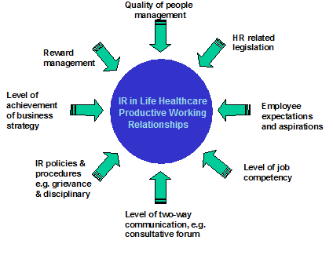
WORKPLACE FORUM/CONSULTATIVE FORUM
SOME VARIABLES INFLUENCING WORKPLACE RELATIONSHIPS

Slide 8
OUR CODE OF CONDUCT
What Is Our Code Of Conduct?
Defines the framework of conduct we consider in our daily activities.
Underpinning this is a central principle of:
dignity
for those we serve &
dignity
for those who serve.
We are a diverse organisation but we are united by these common goals and principles with a shared commitment to the highest standards of integrity and ethical conduct.
Our Code of Conduct allows us to create:
A business culture that sets us apart from competitors and which helps us to be even more successful.
An environment for our patients that helps make their lives better at times of real uncertainty.
A workplace where we all feel we belong, are able to contribute and benefit from our shared success.
Each of us has a personal responsibility to read our Code, understand what it means in the context of our daily activities and apply it consistently.

Slide 9
OUR CODE OF CONDUCT ESSENTIALS
Ethics: moral principles that govern a person's behaviour or the conducting of an activity
Respect: due regard for the feelings, wishes, or rights of others
Confidentiality: the state of keeping or being kept private.
Sustainability: meeting the needs of the present without adversely affecting future generations.
  Regulatory requirements
Regulatory requirements
Anti-bribery
Competing fairly
Conflict of interest
Financial reports & accounting
  Human rights
  Labour rights
  Patient privacy, dignity & respect
  Anti-bullying & harassment
  Equal opportunities
Information governance
Information security
Proprietary information
Health and safety
Environment
Community

Slide 10
OUR REPORTING RESPONSIBILITIES
Life Healthcare views the Life College of Learning both as a responsible social investment in South Africa and as a strategy for addressing our own and the country’s needs for skilled nursing personnel.
We will not walk past inappropriate behaviour, we will take responsibility for raising concerns through the correct channels and we will respond positively to such concerns as they are raised.
Life Healthcare can only maintain our high standards if we encourage patients, colleagues, customers, suppliers and other stakeholders to speak up in the face of inappropriate behaviour.
Individuals should be encouraged to come forward with genuine concerns without the threat of retaliation or victimisation.

Slide 11
OUR REPORTING RESPONSIBILITIES
Life Healthcare views the Life College of Learning both as a responsible social investment in South Africa and as a strategy for addressing our own and the country’s needs for skilled nursing personnel.

Slide 12
TERMS AND CONDITIONS OF EMPLOYMENT
Valid contracts must have the following:
Name and address of employer (company registration number)
Name and address of employee (employee’s ID number)
Job title
Job description / JPM
Date of commencement and termination date (if applicable)
Remuneration
Benefits (Provident fund, medical, death and disability cover, shares and bursaries)
Working hours
Leave provisions (annual, sick, maternity, family responsibility and parental leave)
Unauthorised absence
Termination of contracts
Confidentiality clause/agreement

Slide 13
LEAVE POLICIES AND PROCESSES
Leave
Annual Leave
Shift:168 hours
Non-shift: 160 hours
Pro-rated if less than full-time
Increased per length of service as per policy
Sick Leave
30 days in a 3 year cycle
The line manager will complete a “Welcome back from sick leave interview” on return from sick leave
This is to ensure that you are well enough to return to work
Family Responsibility Leave
3 days per annum
2 days paternity leave per annum
Maternity Leave
Unpaid maternity leave during first 8 months of service.
9 months permanent service, you qualify for either:
4 months at 75% of basic salary
Additional 2 months unpaid can be requested
You can pre-fund before the maternity leave period – ask your FPA
Study Leave
10 days per annum as per policy
Leave without Pay
Employees can request unpaid leave which is subject to management discretion
Life Healthcare views the Life College of Learning both as a responsible social investment in South Africa and as a strategy for addressing our own and the country’s needs for skilled nursing personnel.
Apply via Vision / Kronos

Slide 14
DISPUTE RESOLUTION
DISPUTE RESOLUTION
From time to time, differences between the Company and employees may give rise to disputes being declared. As conflict in inevitable, disputes will be declared in an attempt to follow due process in resolving the differences.
The Company will insist that all disputes are channelled through the respective dispute resolution mechanisms to facilitate constructive and expedient resolutions.
A dispute means any situation where the parties, either as a group, or on an individual basis, reach deadlock concerning a matter that affects the relationship between employer and employee.

Slide 15
CODE OF GOOD PRACTICE
CODE OF GOOD PRACTICE
This code of good practice deals with some of the key aspects of dismissal for reasons related to conduct and capacity. It is intentionally general. Each case is unique, and departures from the norms established by this Code may be justified in proper circumstances. For example, the number of employees employed in an establishment may warrant a different approach.
This Act emphasizes the primary of collective agreements. This Code is not intended as a substitute for disciplinary codes and procedures where these are the subject of collective agreements, or the outcome of joint decision-making by an employer and a workplace forum.
The key principle in this Code is that employers and employees should treat one another with mutual respect. A premium is placed on both employment justice and the efficient operation of business. While employees should be protected from arbitrary action, employers are entitled to satisfactory conduct and work performance from their employees.

Slide 16
INDUSTRIAL RELATIONS – THE GRIEVIENCE PROCEDURE
Life Healthcare views the Life College of Learning both as a responsible social investment in South Africa and as a strategy for addressing our own and the country’s needs for skilled nursing personnel.
 |  | Open Talk Meeting – Immediate Line Manager
Unresolved |  |  |  | Resolved
Complete Grievance Form and hand to immediate supervisor / manager (within THREE working days)
Immediate Manager to submit to the next level of Management to arrange grievance meeting (within THREE working days) |  |  |  | Repeat up to next level
Grievance Meeting |  |  |  | Resolved
Unresolved |  |  |  | INVOKE THE DISPUTE PROCEDURE

Slide 17
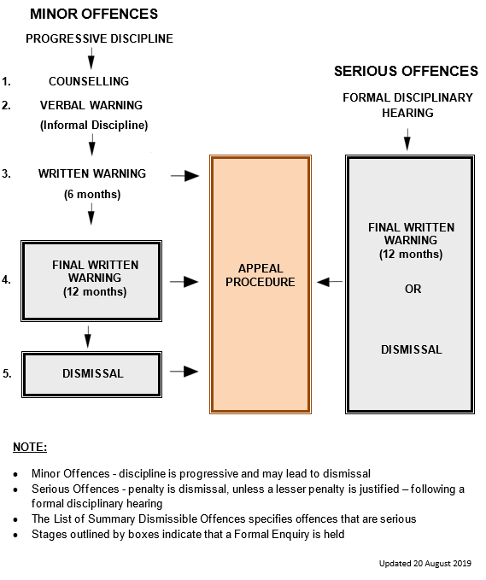
INDUSTRIAL RELATIONS (CONTINUED) – DISCIPLINARY PROCESS
Life Healthcare views the Life College of Learning both as a responsible social investment in South Africa and as a strategy for addressing our own and the country’s needs for skilled nursing personnel.

Slide 18
INDUSTRIAL RELATIONS (CONTINUED) – SUMMARY OF SERIOUS OFFENCES
Serious Offences
Being under the influence of, or taking alcohol or drugs at work.
Assault, verbal or physical or fighting with any other fellow employee, or customer.
Theft, bribery or attempt to/or inappropriately influence someone in authority with fraudulent intent.
Being in unauthorised possession of property of the Company, its customers, suppliers or fellow employees.
Falsifying or providing misleading information.
Providing or submission of fraudulent statements or information.
Changing a medical certificate or producing a false one.
Being in possession of a firearm or dangerous weapons on Company premises unless authorised by the Company in writing
Intentional loss of or damage to property of the Company, suppliers, customer or fellow employee.
Absence without permission for 3 days or more without notification to the Company or without a valid reason. Repeated absence without permission.
Insubordinate behaviour relating to unacceptable conduct in relation to the refusal or failure to carry out lawful and reasonable instructions or verbal or behavioural insolence
Work time recording / clock irregularities.
Participation in unprocedural, industrial action, e.g. riots, sabotage and striking whilst the matter under dispute is being processed in accordance with agreed procedures.
Intimidating, victimization or inciting any other fellow employee by actions or any other means
Life Healthcare views the Life College of Learning both as a responsible social investment in South Africa and as a strategy for addressing our own and the country’s needs for skilled nursing personnel.

Slide 19
INDUSTRIAL RELATIONS (CONTINUED) – SUMMARY OF SERIOUS OFFENCES
Serious Offences
Any deliberate action which does or has the potential to disrupt industrial relations between management and employees, individuals and groups. (For example - abusive language)
Non-compliance with any Company policies, procedures protocols or regulations or action that could potentially put the safety of employees or customers or Company operations at risk
Driving a Company vehicle without being in possession of a valid driver's license and without the necessary training
Professional or technical negligence or misconduct which does or may result in the risk to the health or life of any person.
Unprofessional conduct/behaviour towards fellow employees, its customers or clients that negatively affects the good standing of the Company
Breach of confidentiality, trust or disclosure of company operating procedures to persons other than authorised employees
Gross negligence which affects the profitability and / or standing of the Company and / or the trust relationship between the Company and the individual
Sleeping on duty
To engage in employment with another employer without permission
Excessive use or abuse of company internet, e-mail or telephone facilities
Repeated failure to obey a reasonable and legal instruction
Sexual harassment
Life Healthcare views the Life College of Learning both as a responsible social investment in South Africa and as a strategy for addressing our own and the country’s needs for skilled nursing personnel.

Slide 20
PROTECTION OF PERSONAL INFORMATION ACT (POPIA)
What is POPIA?
POPIA is a new law to ensure entities and people who use other people’s information do so in a responsible way respecting the privacy of the information we access and use What is personal information? Any information about a person or company that is not publically available.
If you are aware of personal information being accessed by an unauthorised party immediately report the breach to the Group Information officer, Michael Dorfan on +27 11 2199232
Life Healthcare views the Life College of Learning both as a responsible social investment in South Africa and as a strategy for addressing our own and the country’s needs for skilled nursing personnel.
What is expected of me?
When collecting personal information notify why you need it. If you collect personal information from another source, in most cases let the data subject know you are collecting/using their information, explain how you are getting it and what you will be using it for. Once information has been collected, and you access it as an authorised recipient, at all times keep the information away from people who are not authorised to access it, examples of safeguards could include: 1. Physical – locking it away. 2. Administrative – adhering to information handling policies 3. Technical – Password protect or encrypt the information if it is classified as sensitive, or de-identify it so it cannot be traced back to a person. 4. Destroy the information if it is no longer required or needed for its business or any legal purpose. You need to be careful and avoid communicating information in a way that is not secure – do not take private pictures without permission, and do not store other sensitive personal information on non-business approved devices and or cell phones that are not secure. Be careful and do not discuss or remove information obtained during the course of your work, be it through verbal conversations and never post personal information on social media. Where you share information with another authorised person please ensure they are aware of and apply the POPIA conditions too!

Slide 21

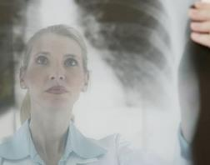
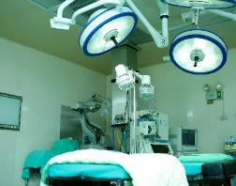

Thank you

