Slide 1
Professional nursing associations and trade unions
HC and D1 FNP LO 1.3
M de Beer

Slide 2
Outcomes
What is the roles and functions of nursing associations and trade unions?
Define indemnity cover and its purpose
Differentiate between strikes and picketing vs Professional practice

Slide 3
PROFESSIONAL Nursing associations
Notes:
Specialist subgroups – professional societies – formed to promote professional development

Slide 4
Introduction
Essential structures in the profession as they contribute directly and indirectly to the safety and quality of patient care
First priority is the well-being of the members of the profession
Contribute to the safety and security of patients and the health of the nation
The Constitution of the Republic of South Africa 1996, determines that all employees have a right to freedom of association
Notes:
The SANC – 1st priority is to protect the SA public through governing the nursing profession
Nurses and midwives can join a trade union/professional organization or association of their choice

Slide 5
What is the difference between a trade union and professional association?
PROFESSIONAL ASSOCIATION:
Promote solidarity among members – remain in touch with the community
Professional identity – restricting membership
Increase service potential – ongoing education, training, monitoring conduct
Keeps the welfare of the society in mind
Some offer professional indemnity
Publishing of journals
Research – encouraged by association, publication
Practice standards
TRADE UNION:
“An association of employees whose principal purpose is to regulate relations between employers and employees, including any employers’ organisations” Labour Relations Act 1995 section 213

Slide 6
FUNCTION OF TRADE UNIONS
To ensure that the ethical principles of justice/fairness is practised in the relationship between employees and employers
Representing their members in grievance and disciplinary matters – with the goal of working towards a harmonised workplace
Organize and coordinate industrial action (strike)
Notes:
Protecting nurses against exploitation and hazardous employment situations

Slide 7
Trade unions must be registered with the Department of Labour in terms of the Labour Relations Act
Deregistered for not complying with the requirements
Nurses can belong to any union registered with the Department of Labour
DENOSA specifically represents nurses and they combine union and professional functions

Slide 8
Benefits of membership of an association or a professional society
Newsletters, journals, access to workshops, webinars
Stay up to date with developments in the broader nursing profession
Alignment with a nursing society that supports your specialty
CPD
Influencing policy and legislation – quest for safe and quality care
Involvement in research projects
Collective vice in nursing issues
Leadership development and visibility through active involvement
Networking opportunities
Broadening our perspectives

Slide 9
ROLES OF PROFESSIONAL ASSOCIATIONS OR ORGANISATIONS
Promote solidarity among members – remain in touch with the community
Professional identity – restricting membership
Increase service potential – ongoing education, training, monitoring conduct
Keeps the welfare of the society in mind
Some offer professional indemnity
Publishing of journals
Research – encouraged by association, publication
Practice standards
Notes:
Geyer, N. et al. 2022. A new approach to professional practice. 2nd Edition, JUTA. p. 239

Slide 10
Indemnity

Slide 11
Indemnity definition
Insurance cover
Required by law and the employer
Protection against all claims potentially brought against the nurse for negligence on duty
Negligence implies failure to act properly according to expected standard OR failure to act at all.

Slide 12
Notes:
From the student contract

Slide 13
DENOSA
Union:
Responsible for collective bargaining to determine wages, terms and conditions for employment, etc.
To strengthen nurses’ collective bargaining power
Affiliated with Congress of South African Trade Unions (COSATU), and the ICN.
Professional:
Responsible for policy statements on key issues, e.g. standpoint on abortion or research ethics.
Assists with CPD – offers grants and bursaries
Promotes scholarships through its accredited journal – Curationis.
Provides professional indemnity insurance – assists nurses during legal litigations.

Slide 14
South African democratic nurse’s union (SADNU)
Founded in 1995
Strives to improve working conditions
Through collective bargaining
Affiliate of COSATU
Notes:
COSATU – Congress of South African Trade Unions – biggest federation in the country with over 1.9 million members

Slide 15
National education, health and allied workers union (NEHAWU)
Represents a broad spectrum of workers
Founded 1987
Affiliated with COSATU
Its strongpoint is collective bargaining
Based on the following principles:
Worker control of the union
Worker leadership
Democratic decision making through mandates and report-backs
Worker solidarity

Slide 16
Health and other services personnel trade union of SA (HOSPERSA)
Members of public service and the private sector, and NGO’s
Most members from private sector: Netcare, Life, Mediclinic, and independent hospitals, SA National Health Lab Services, pharmacies, etc.
In favour of:
Collective bargaining
Provision of benefits to members
Industrial actions
Political activity

Slide 17
CHALLENGES
Acknowledgement of the complexity of the environment
Unions need to create awareness among all stakeholders of the complexities of the healthcare profession
Notes:
At one stage or another, we are all users of healthcare services, and should be concerned about the kind of reception we get when entering a healthcare facility, and the contribution we can make to ensure nurses feel adequately protected and motivated

Slide 18
Strikes
Essential services personnel can take part in strike action only where a minimum service agreement is in place
Public sector nurses are denied the right to strike (employment issues are ignored at the bargaining table)
This leads to frustration → low morale → leaving health services→ worsening the nursing shortage

Slide 19
Essential and maintenance service
A service that would / could endanger lives, personal safety of health, if the service was to be interrupted.
A service that can cause physical destruction to a working area if it is interrupted.
E.g. workers in the health service industry, electricity and sewage.
Disputes in these services have to be referred to a bargaining council / Commission of Conciliation, Mediation and Arbitration (CCMA).

Slide 20
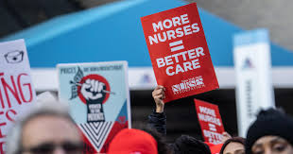
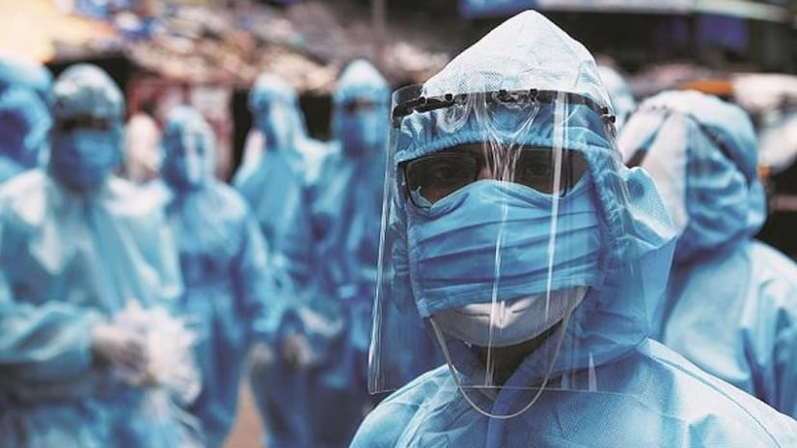
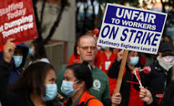
Picketing vs striking
Notes:
Pi

Slide 21
Picketing
Union members standing at an entrance to workplaces with various banners and placards, stating their reason for being there.
Enables strikers to communicate their message.
Rules for picketing as per LRA:
Authorise by union to be peaceful
Purpose:
Make sure the strike is supported
Persuade non-strikers to join
Employer may make use of replacement labour during a strike.
Notes:
Picketing at the workplace is effective in private healthcare – avoid negative publicity

Slide 22
Strikes and ethical concerns of a nurse
Nursing is an essential service
Striking becomes an ethical dilemma for nurses (Nurses Pledge)
Nurses are meant to be caring individuals, but are also workers and breadwinners, and has the right to work in a safe environment.
Nurses should take all measures to ensure they are not risking the lives of their patients.
Nursing strikes lower the standard of patient care.

Slide 23
Class activity
Debate:
Group 1: in favour of striking as a healthcare professional
Group 2: against striking as a healthcare professional
JUSTIFY

Slide 24
Debate rules
Do not make personal attacks
State your points based on / supported by facts
Do not respond with emotions
Respect each other's point of view.
Be respectful and let each other talk – do not interrupt each other
Conduct a civil debate – no shouting.

Slide 25
QUESTIONS ?

Slide 26
REFERENCES:
Geyer, N. et al. 2022. A new approach to professional practice. 2nd Edition, JUTA
Pera, S., van Tonder, S. 2022. Ethics in Healthcare. 4th Edition, JUTA

